Slide 1


Faculty of Computing and Informatics
Week 5
Database Design

Slide 2
Recap
In the previous lesson, we discussed
Database development life cycle
Activities involved at each phase

Slide 3
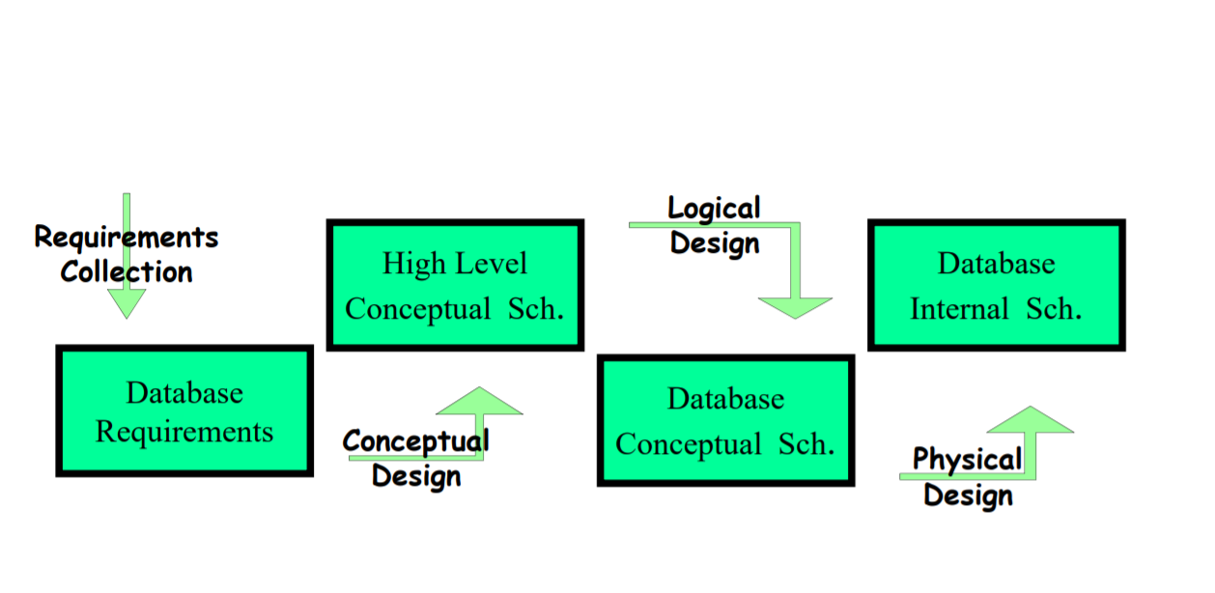
Database Development lifecycle
The diagram summarises the phases in the Database development process.
Take note of the activities involved at each of the phases.

Slide 4
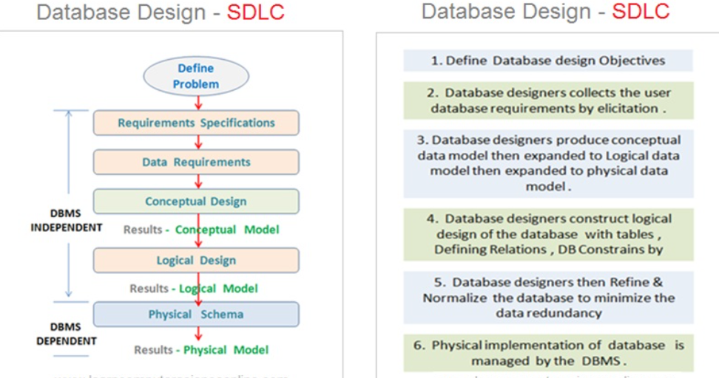
Database development process

Slide 5
Relationships -Degree of Relationship
UNARY
EMPLOYEE
Manages
PERSON
Is_married_to
One-to-One
One-to-Many
PARTS
TERNARY
VENDOR
Supplies
WAREHOUSE
Many-to-many

Slide 6
Multiple Relationships
In some situations an organisation may wish to model more than one relationship between the same entity types
Exercise: Identify possible relationships between a Lecturer entity type and a Subject entity type
Works_in
Supervises
EMPLOYEE
DEPARTMENT
Manages

Slide 7
Relationships –Cardinality of a Relationship
A recap on cardinality
One – to – One
  Each entity in the relationship will have exactly one related entity
One – to – Many
  An entity on one side of the relationship can have many related entities, but an entity on the other side will have a maximum of one related entity
Many – to – Many
  Entities on both sides of the relationship can have many related entities on the other side

Slide 8
Objectives
By the end of this lecture, students should be able to
Draw ERDs following Chen’s and Crow’s Foot notations

Slide 9
Constraints
A constraint is an assertion about the database that must be true at all times
Constraints are part of the database schema for example
Keys: studentNumber uniquely identifies a student
Single-value constraints: a person can have only one father
Referential integrity constraints: if you work for a company, it must exist in the database Domain constraints: peoples’ ages are between 0 and 150
Cardinality constraints: at most 100 students enroll in a course

Slide 10
Entity Relationship Model
An entity-relationship (E-R model) model is a detailed logical representation of the data for an organisation or for a business area.
The E-R model is expressed in terms of:
  Entities in the business environment
  The relationships (or associations) among these entities
  A cardinality specifies the number of instances of entity B that can (or must) be associated with each instance of entity A, and vice versa
  The attributes (or properties) of both the entities and relationships
The E-R model is normally expressed as an Entity-Relationship diagram

Slide 11
E-R Data Model
After the requirements have been gathered, they are transformed into an Entity Relationship (E-R) Data Model.
The most important elements of E-R Models are:
  Entities
  Attributes
  Relationships

Slide 12
Entity-Relationship Diagrams
General notation on ERDs
  Entity classes are shown by rectangles.
  Relationships are shown by diamonds.
  The name of the entity is shown inside the rectangle.
  The name of the relationship is shown near the diamond.

Slide 13
Tips on ERDs
Identify entity types by searching for nouns and noun phrases
Assume all entities are strong and check for weak ones on a later pass
You need an identifier for each strong entity
Assume all relationships have optional participation and check for mandatory (total) ones on a later pass
Expect to keep changing your mind about whether things are entities, relationships or attributes
Keep the level of detail relevant and consistent (for example leave out attributes at first)
Approach diagram through different views … … and merge them

Slide 14
Notations for
Entity-Relationship Diagrams
Information Engineering (IE) [James Martin 1990]—Uses “crow’s feet” to show the many sides of a relationship, and it is sometimes called the crow’s foot model.
Integrated Definition 1, Extended 3 (IDEF1X) is a version of the E-R model that is a national standard.
Unified Modeling Language (UML) is a set of structures and techniques for modeling and designing object-oriented programs (OOP) and applications

Slide 15
Chen’s Notation
Entity
Attribute
Relationship
Cardinality
Student
StudentNumber
GivenName
Student
enrols
Course

Slide 16
Attributes
attributes are represented as an oval.
Flight_Number
Date
ID
Name
ID
Number_of_Passengers
STUDENT
FLIGHT

Slide 17

Relationship
Relationship- shows a relationship as a lozenge (‘diamond’ shape) connected with lines to the entities
The name of the relationship is shown in the lozenge.
The name of the relationship is usually written to make sense reading right from left, or top to bottom.

Slide 18
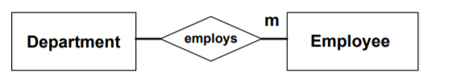
Relationships
from department to employee, we also concluded that a department can employ several (i.e. one or more) employees.
This is shown as an “m” at the far end of the relationship as we are reading it.

Slide 19
Cardinality
One-to-one (1:1) – both entities are associated with only one attribute of another entity
One-to-many (1:N) – one entity can be associated with multiple values of another entity
Many-to-one (N:1) – many entities are associated with only one attribute of another entity
Many-to-many (M:N) – multiple entities can be associated with multiple attributes of another entity

Slide 20
Relationships -Degree of
Relationship (Binary examples)
EMPLOYEE
Is_assigned
Office
One-to-one 1:1
ACCOUNT
Has
EXPENSE
One-to-many 1:M
STUDENT
Enrolls_in
COURSE
Many-to-many N:M

Slide 21
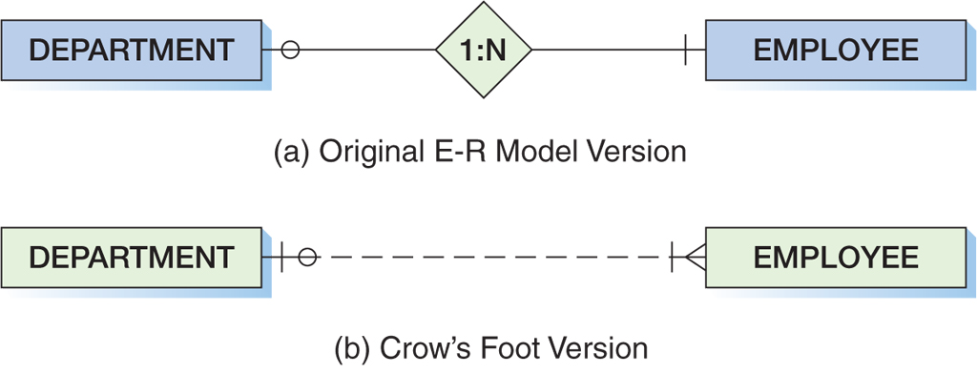
Crow’s Foot Example:
One-to-Many Relationship
Kroenke & Auer (2013)

Slide 22
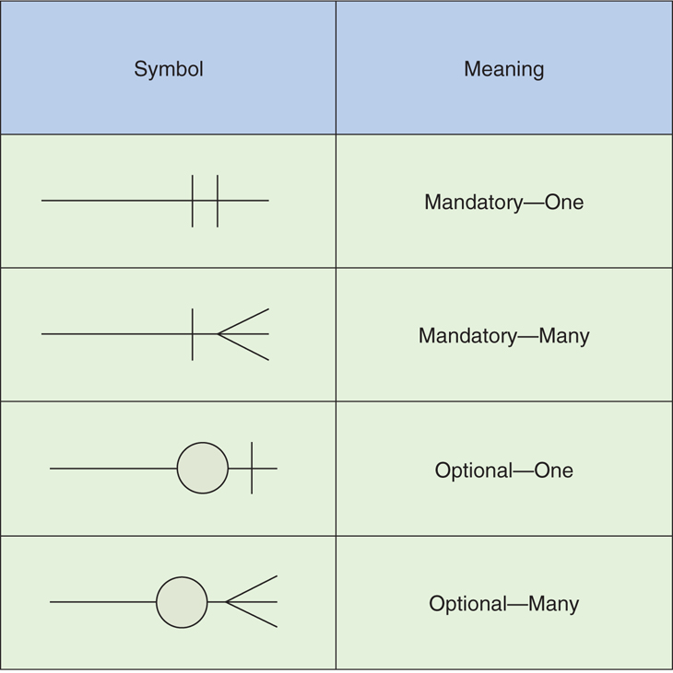
Crow’s Foot Notation
Kroenke & Auer (2013)

Slide 23
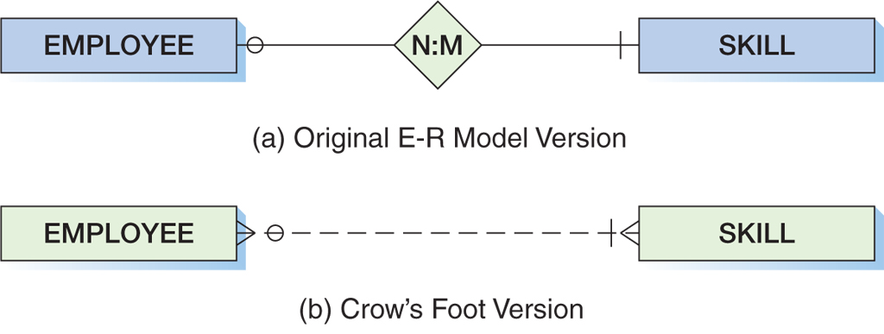
Crow’s Foot Example:
Many-to-Many Relationship
Kroenke & Auer (2013)

Slide 24
Entity-Relationship Diagram
Examples

Slide 25
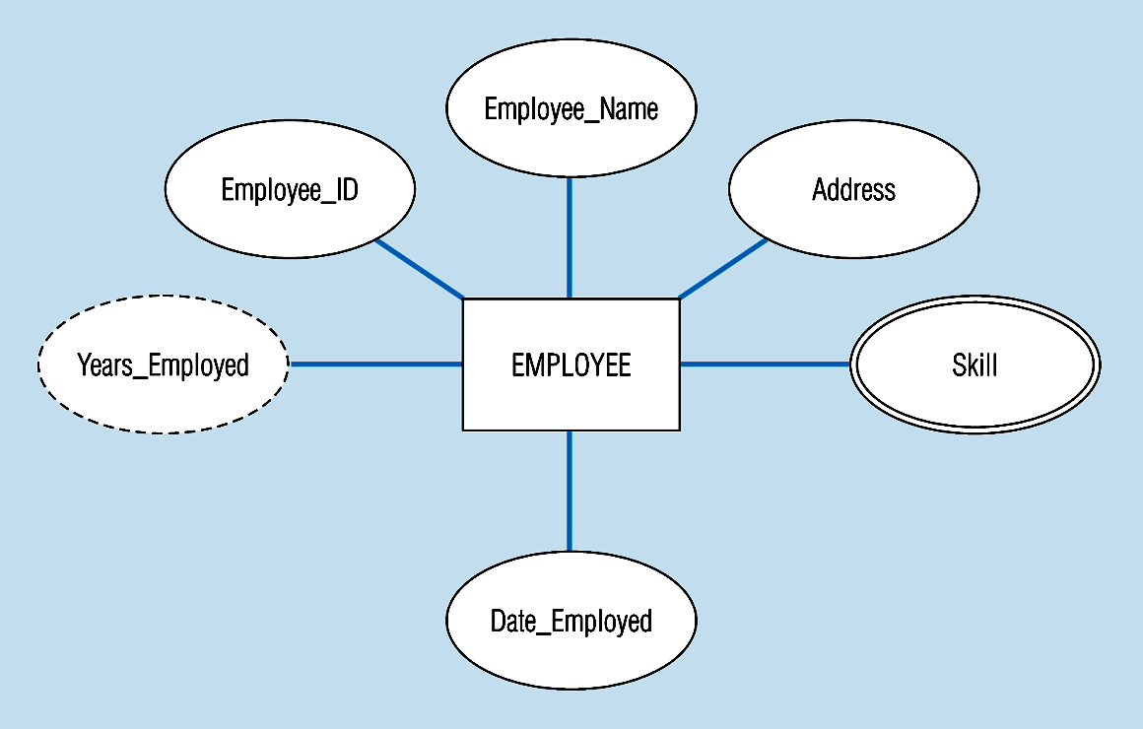
Entity with a multi-valued attribute (Skill) and derived attribute (Years_Employed)
What’s wrong with this?
Multivalued:
an employee can have
more than one skill
Derived
from date employed and current date

Slide 26
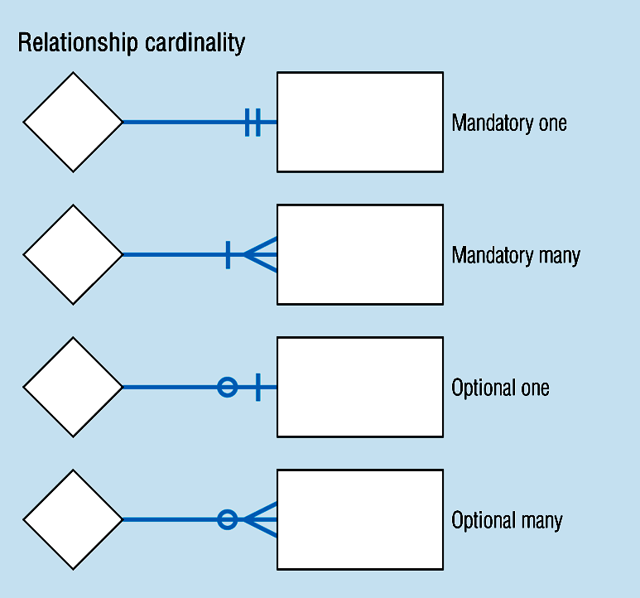
Cardinality – Diagramming Convention

Slide 27
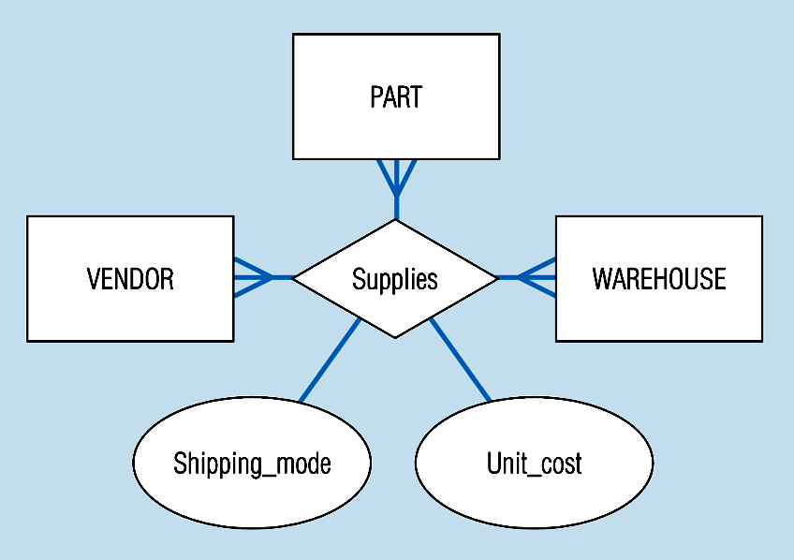
Ternary relationships
Note: a relationship can have attributes of its own

Slide 28
References
Kroenke, D. M. & Auer, D. (2018). Database concepts (7th ed.), Pearson
Kroenke, D. M. & Auer, D. (2018). Database concepts (9th ed.), Pearson

Slide 29
Note
In the next lecture, we will discuss normalization and functional dependency
Draw ERDs using different notations (practical classes)
Explore tools that we can use to draw the ERDs.

